Slide 1

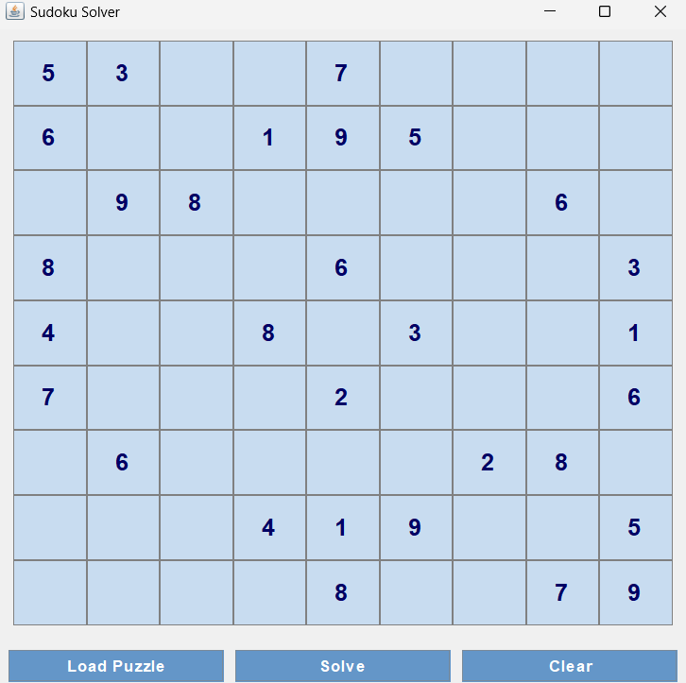
Sudoku Solver GUI
This Java application provides an intuitive Sudoku solving experience. Users can input puzzles, initiate the solving process, and visualize the step-by-step solution. The powerful algorithm quickly finds solutions to challenging puzzles.
The GUI offers customization options, including visual styling, animation speed, and saved puzzles. This allows users to tailor the application to their preferences.

Slide 2
Graphical User Interface (GUI)
The Sudoku Solver GUI is built using Swing, a Java library for creating graphical user interfaces. The primary component is a 9x9 grid of text fields, representing the Sudoku puzzle grid. Users can input numbers directly into these fields. Additionally, there are buttons for loading puzzles from external files, initiating the solving process, and controlling the animation speed of the solution.

Slide 3

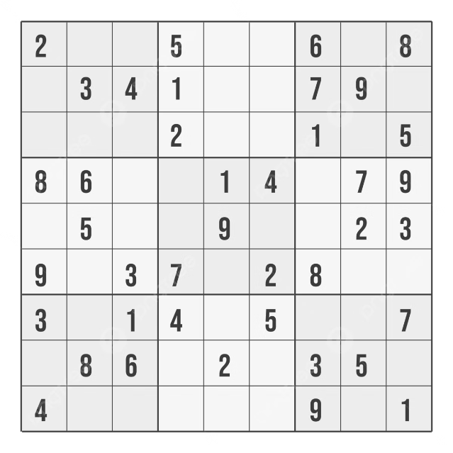
Puzzle Input and Display
Users can input Sudoku puzzles directly into the grid by typing numbers into the text fields. Alternatively, they can load puzzles from external files, either in plain text format or a custom file format. The application supports various file formats to accommodate different puzzle sources.
The GUI displays the puzzle in a visually clear and organized manner. Each cell in the grid is represented by a text field, allowing for easy input and modification. The grid is designed to visually highlight the 3x3 subgrids within the puzzle, making it easier for users to understand the puzzle structure and input values correctly.

Slide 4
Solving Algorithm
The Sudoku Solver GUI employs a backtracking algorithm to solve puzzles. Backtracking is a recursive approach that systematically tries different values for each empty cell in the puzzle. The algorithm works by checking if a candidate value is valid (doesn't violate the Sudoku rules) before placing it in the cell.
If a candidate value is invalid, the algorithm backtracks to the previous cell and tries a different value. This process continues recursively until a solution is found or all possible combinations have been exhausted. The backtracking algorithm is known for its efficiency in solving Sudoku puzzles.

Slide 5
Solving Animation
The application offers a visually engaging animation of the solving process. As the backtracking algorithm iterates through different candidate values, the GUI highlights the currently considered cell and its candidate values. The speed of the animation can be adjusted by the user using a slider control, allowing them to control the pace of the solution process.
The animation serves two primary purposes: 1) To provide visual feedback to users on the algorithm's progress, and 2) To visually demonstrate the backtracking process. This makes the solving process more interactive and engaging for users.

Slide 6
Puzzle Loading and Saving
Users can load Sudoku puzzles from external files using the "Load Puzzle" button. The application supports various file formats, including plain text files and custom formats that may be used by other Sudoku puzzle sources.
Similarly, users can save solved puzzles or puzzles in progress to files. This allows users to revisit puzzles later or share them with others. The saving functionality enables users to keep track of their progress and continue solving puzzles at a later time.

Slide 7
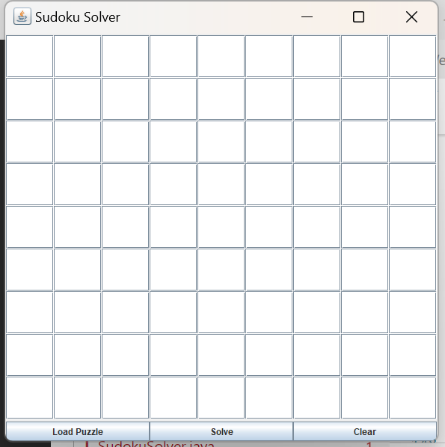
When you run your code

Slide 8
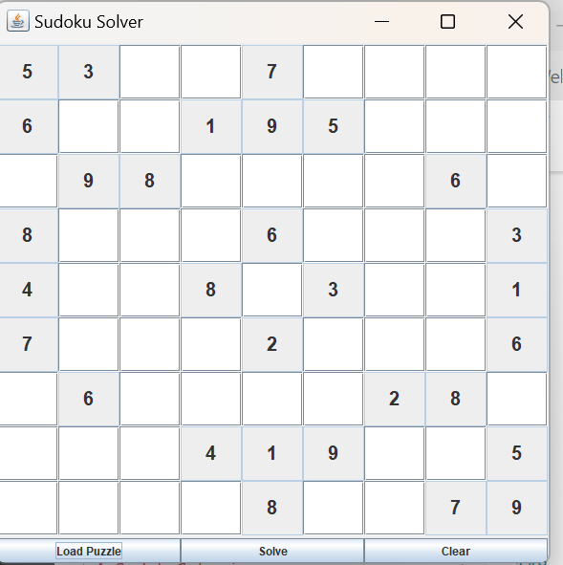
After clicking LOAD PUZZLE button

Slide 9
Conclusion
.
This Sudoku Solver GUI project successfully combines Java Swing for the graphical interface with a backtracking algorithm to solve Sudoku puzzles. It allows users to interactively load, solve, and clear puzzles while visualizing the solving process step-by-step. The use of multithreading (Thread) and SwingUtilities.invokeLater() ensures smooth execution of the solving algorithm without freezing the GUI.

